Slide 1
Warm Up: Hapiness
*Answer all questions in complete sentences unless otherwise specified.
1. Do you feel your life is balanced? How
2. Do you have balance between your school life and your home life?

Slide 2
Happiness is a Balanced Lifestyle
Objective: To help students identify the components of a balanced lifestyle.

Slide 3
Emma & Isaac
Read Emma & Isaac’s story on
pg. 64.

Slide 4
Trouble Balancing their Lives
Emma’s life is incomplete.
There are times when it is necessary to center your attention on one part of your life (illness, finishing work, etc.)
However, she cannot keep her current pattern.
Her life is not balanced.

Slide 5
Trouble Balancing their Lives
Isaac is probably aware that he has too much on his plate.
Isaac needs to decide which activities are most important to him and which ones he can give up easily.

Slide 6
Balanced Lifestyle
Everyone’s balanced lifestyle looks differently from one person to the next.
Some people value work.
Some value family.
Some value their health.
In general, a healthy life will be balanced emotionally and physically and contain time for the following.

Slide 7
Elements of a Balanced Lifestyle: Physical Health
Time to sleep, eat wisely; contain exercise and relaxation.

Slide 8
Elements of a Balanced Lifestyle: Work
How important is it to you?
Will you work part time or full time? More?
Do you want time to hang out with your children?

Slide 9
Elements of a Balanced Lifestyle: Family / Relationships
Will you have children?
Surround yourself with a group of friends?
Emma would most definitely be happier if she had good friends or a circle of acquaintances she could speak with frequently.

Slide 10
Elements of a Balanced Lifestyle: Leisure and Recreation
Time for hobbies, and leisure activities that add to your life.
Will you travel?
Have a garden?
Follow your favorite sports team?
Go to the movies?

Slide 11
Elements of a Balanced Lifestyle: Spiritual Life
Many people realize their spiritual needs through their religion (or meditation, reading, walking, etc).
Others choose to, “give something back” to the world by volunteering for some cause.

Slide 12
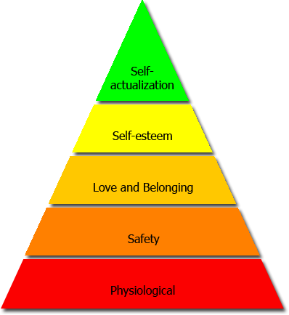
Modified Maslow
Self Confidence
Self Esteem
Belonging
Love
Stability
Security
Food & Shelter
Health
External
Internal

